Slide 1
Student Online Class registration Thurman Peele CST 499 Capstone for Computer Software Technology Dr. Amjad Alkilani July 13, 2020

Slide 2

objectives
Summarization of the SRS document
Showcase the UML design model
Explain the design of the landing, login, and enrollment pages
Explain the Mysql database and class registration
Discuss the php code

Slide 3
Srs document
The srs document is the bases of the whole project. It’s the structure that the team will follow in the development of the product. It will describe what the software will do and how it will be expected to perform. It will also describe the functionality.
The key aspects are:
Overall description of the project.
Product features
Design Constraints
User Interface
Functional Requirements
Non-functional Requirements
The New registration system will be used by students that are familiar or not with the online registration process. The scope shall be user friendly for customers and administrators. Kuchta & Padhiyar states “The first stage of the formalized process is the transformation of requirements into analytical models. As a rule, two models are created: a functional model (e.g. a case of use case model) and a static structure model (e.g. a class model). The first of them can be easily built on the basis of functional requirements specifications - firstly each functional requirement is mapped to one or more use cases, and then the usage case model is supplemented and refined (e.g. by entering relationships between use cases)”(Kuchta & Padhiyar, 2018).

Slide 4
UML Design models
These UML design models are used to describe models which can be done by text and visually. UML describes the structure in terms of software, interactions and behavior before the process of coding begins. Within the UML model you have:
Class – Which will explain all the classes the software system will have.
Objective – Which will describe the elements within the classes.
Interface – Describing the functions of a method.
Use cases- Will describe how the user will interact with the software system.

Slide 5
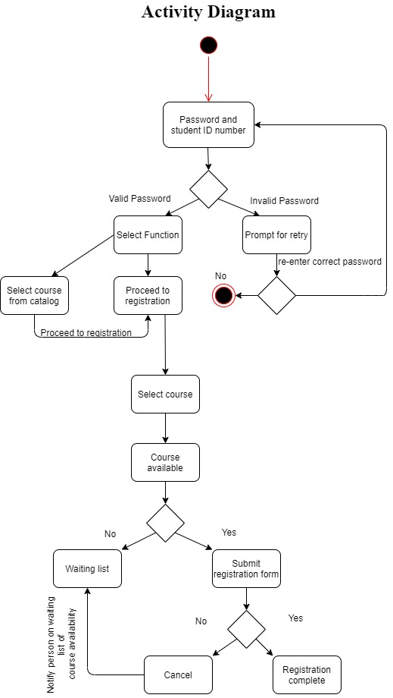
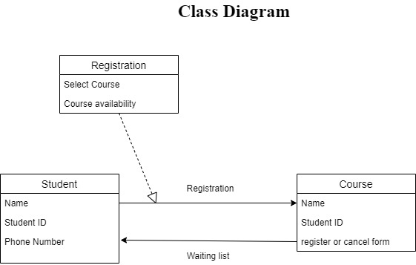
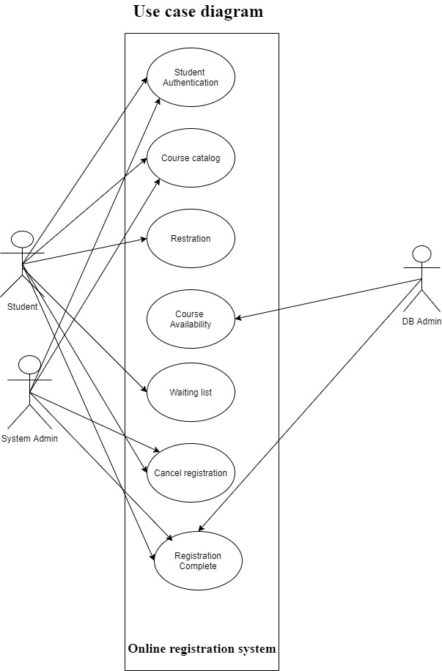
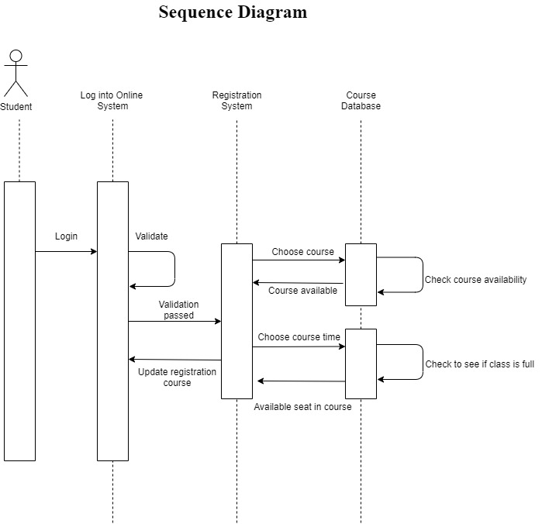
UML design model diagrams

Slide 6
Combining all functionalities
To combine all my functionalities, I had to reference each page to one another. So, for instance my login page references/includes my config page because of the connection to the database to determine if the student completed the online registration process. My Registration page includes my config code and the login code so after the student is finished with the enrollment process, they will be direct to the login page. For the profile page the student can view their information and to get that function to work I had to have a connection to the database to pull the information based off which student is logged in.

Slide 7
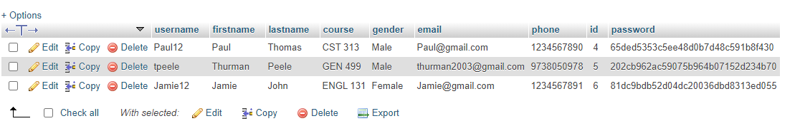
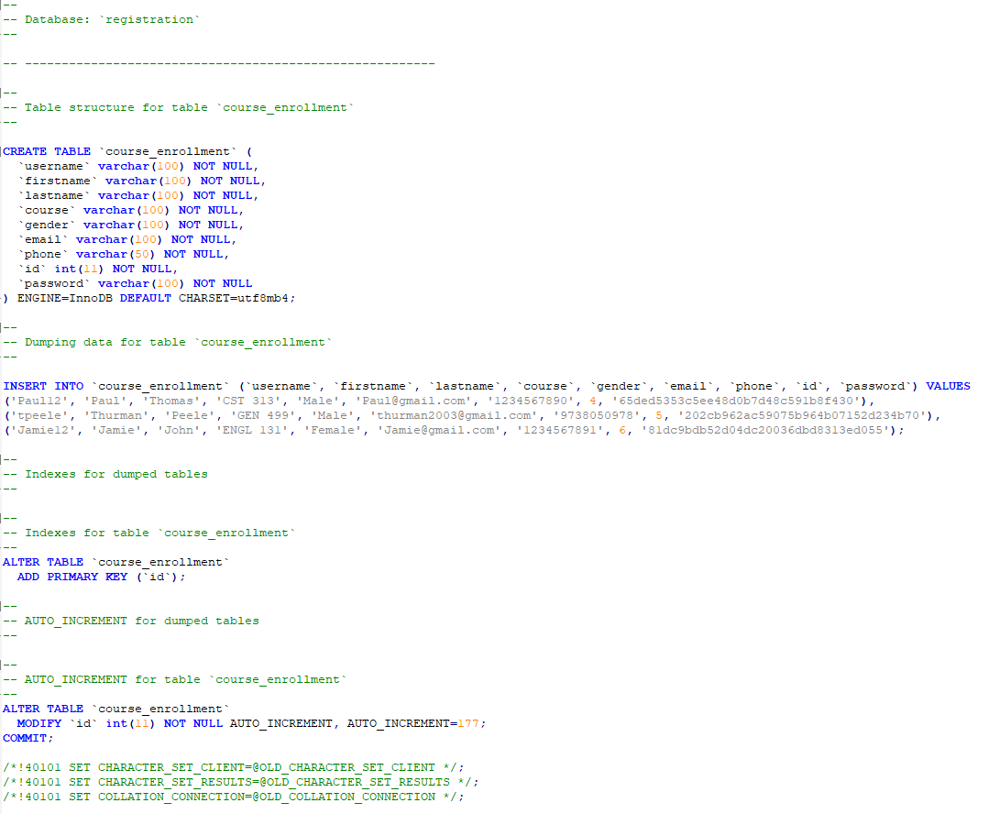
Creating My database
To create the database I used php My Admin to create my database and tables. The connection to php is need first and then I can run the script to the right and my database and tables are created. The database is used to house and protect the student information. Information can be inserted, delete, updated, and exported to view. Once a student has completed the enrollment process, that information is sent to the database to be stored.

Slide 8
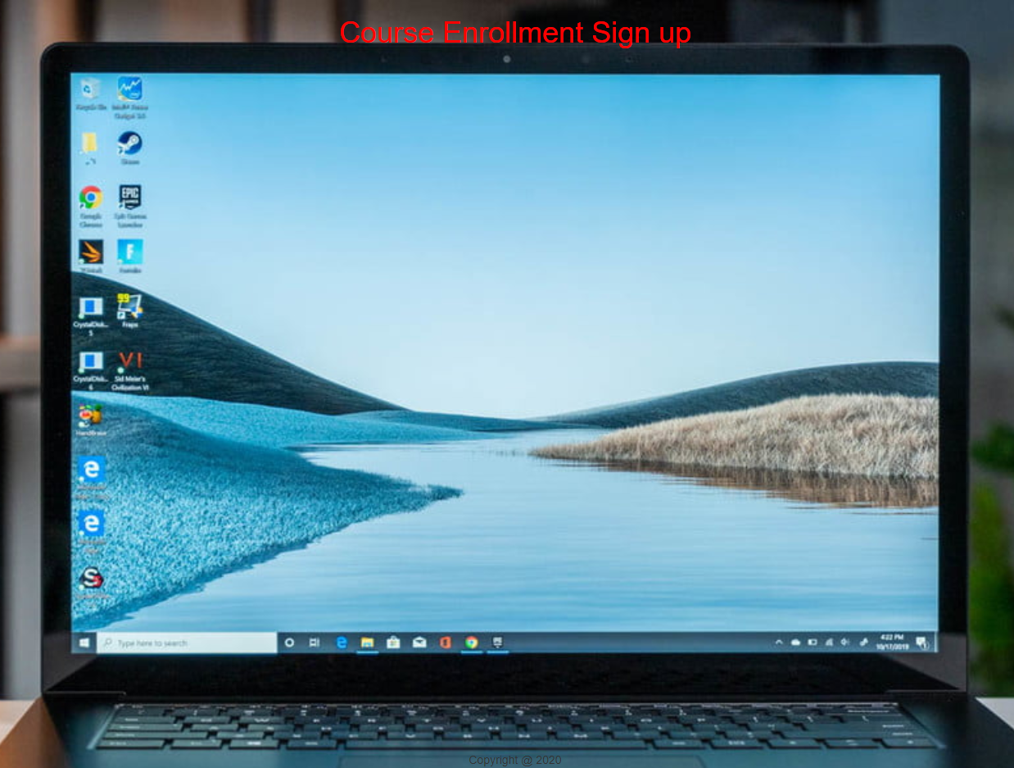
creating the landing page
The purpose of me creating a landing page is to house the navigation links, background information, and the overall style of the website. To the right you will find landing page and on the next page you will find the code I used to create it. Each link (Home, Contact Us, Login, Registration, and profile) will direct you to its respected pages.

Slide 9
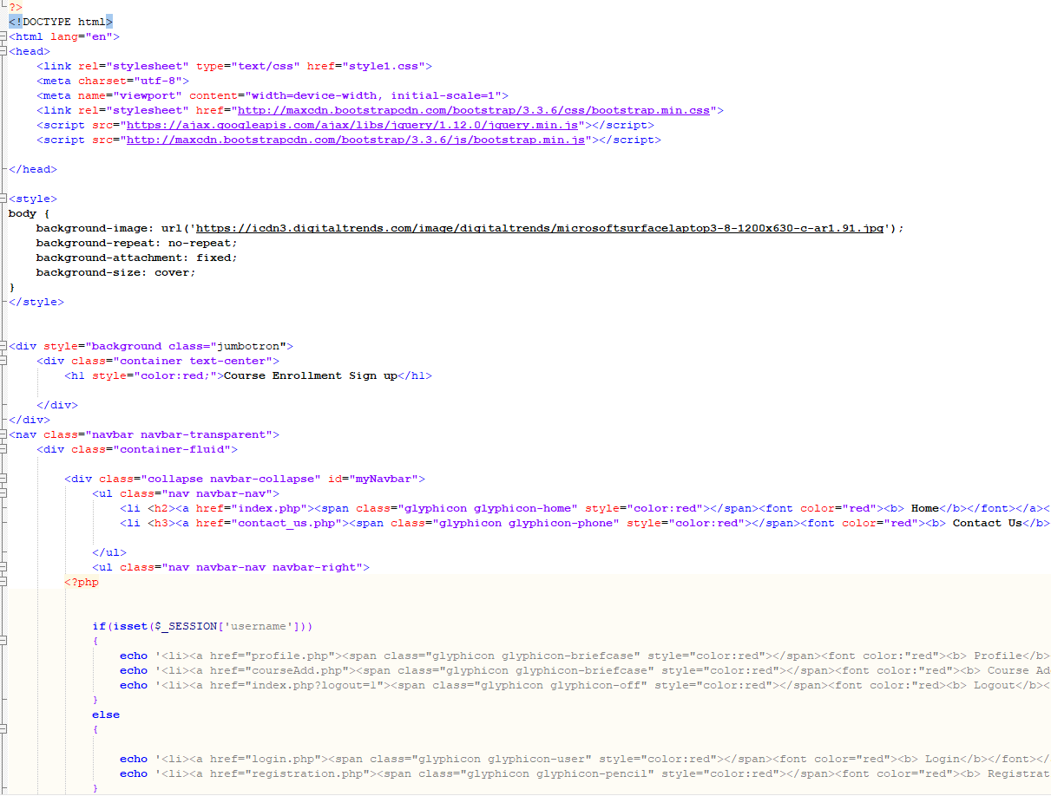
Landing page code
For this code I created and error reportingfunction to capture any error in my code. Next, I included a style link so that everything is formatted to my liking. I used a background image that was found online. I want to keep the navigation bar transparent, so I created a class to complete that action.

Slide 10

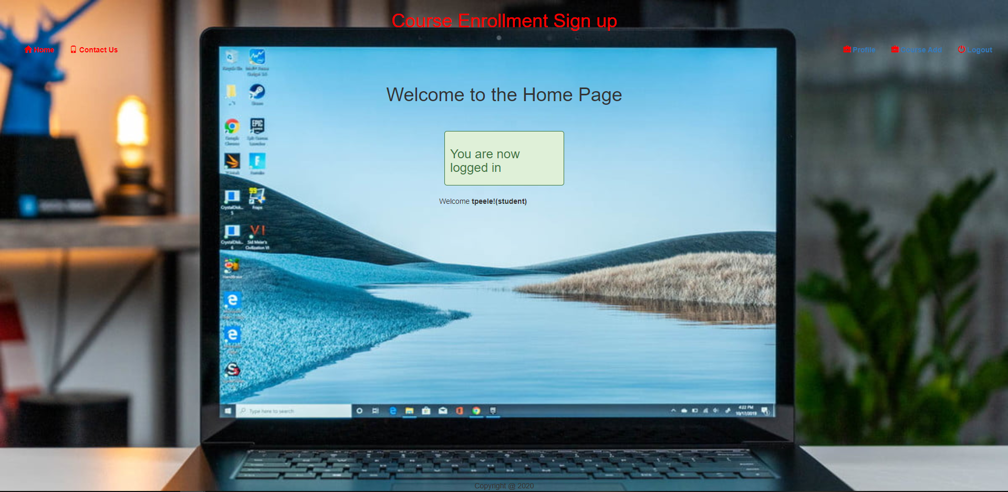
registration page
For each new student they will have to register before access is granted into the company’s website. On the Home page when the registration button in clicked, the student will be directed to the registration page where they can signup and access the website. Once the registration process in complete the user is automatically logged in and redirected to the index page.

Slide 11
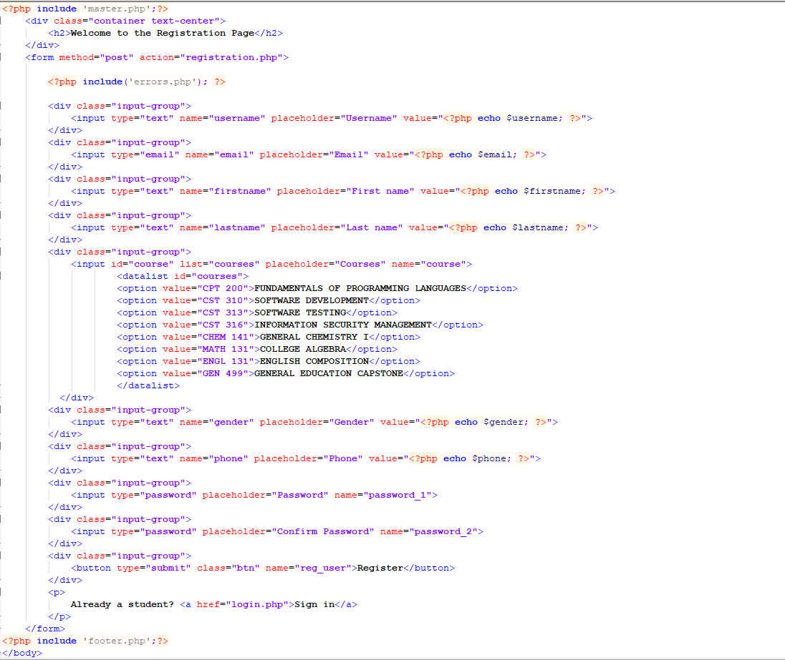
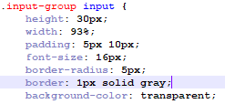
Registration page source code
If you recall from my master file, I had a link directing the students to register before being able to access the website. To the right you will find the code I use to create the registration page and the stylesheet for the form.

Slide 12
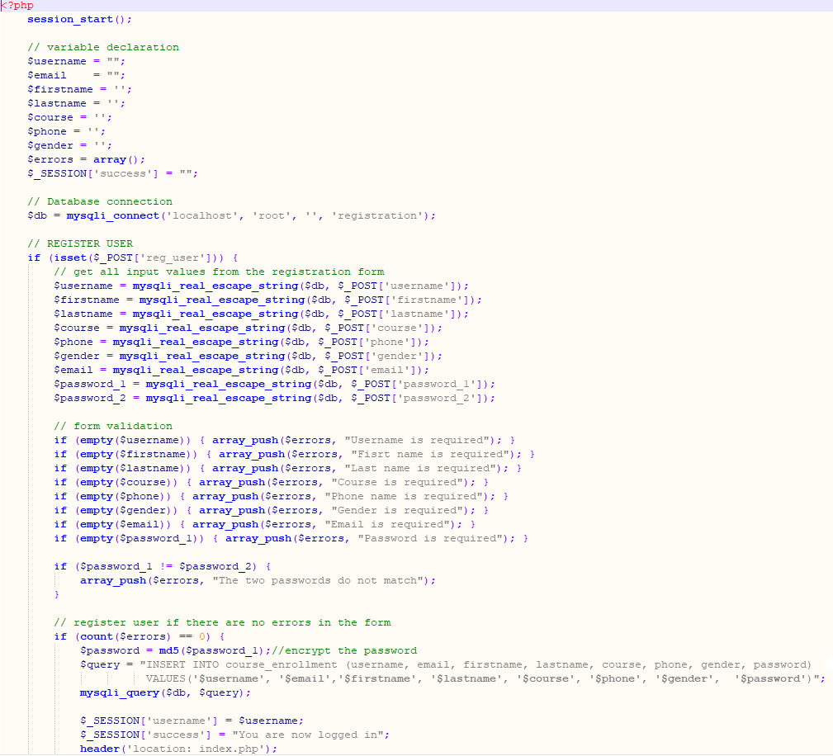
Configuration page
The configuration page is where the connection to the database is established. At the very top of the page I have a start session function that will create a new session for each student. The configuration page not only makes the connection but also store and validates the student’s information.

Slide 13

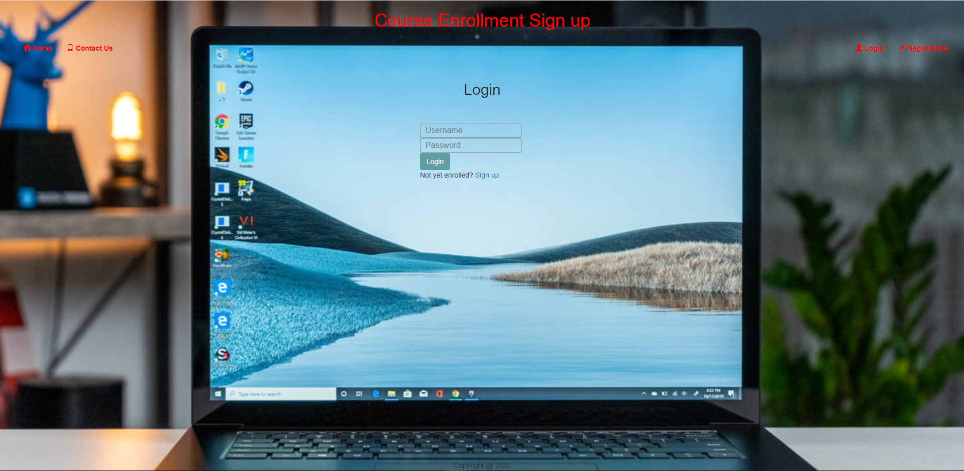
Login page
Everything that I have on my login page is very similar to my registration page. I have the required fields that need to be field in and a link that will direct you to the registration page if you don’t have a username and password. I included at the top of my code the configuration file so, if they already have credentials, they can sign-in and their profile information is pulled from the database.

Slide 14
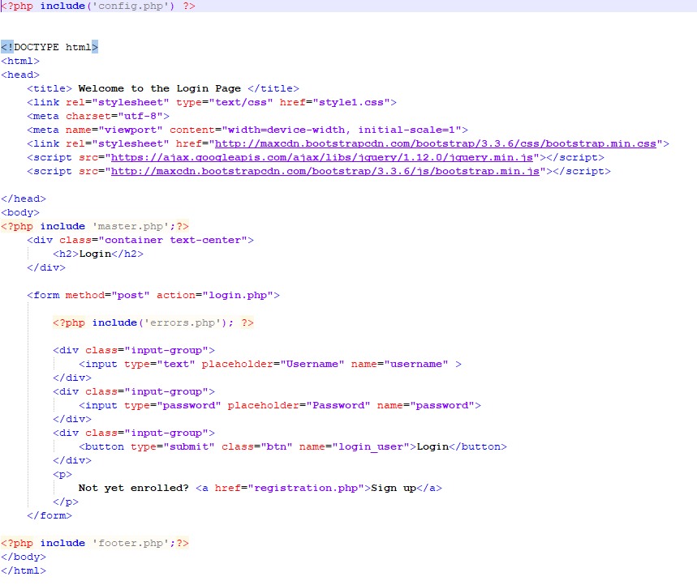
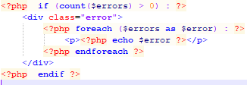
Login page code
Like I mentioned before the login page is very similar to my registration page where I have fields that need to be filled in. A stylesheet to create the format and the transparent fields. I also included an error file to catch any errors in my code.

Slide 15

Student’s profile page
The profile page is all the information the student’s entered in the registration page. The data was gathered and stored using the $_POST super global function. Once the student has completed the registration form and logged in, they can view all the information they entered and the registered courses.

Slide 16
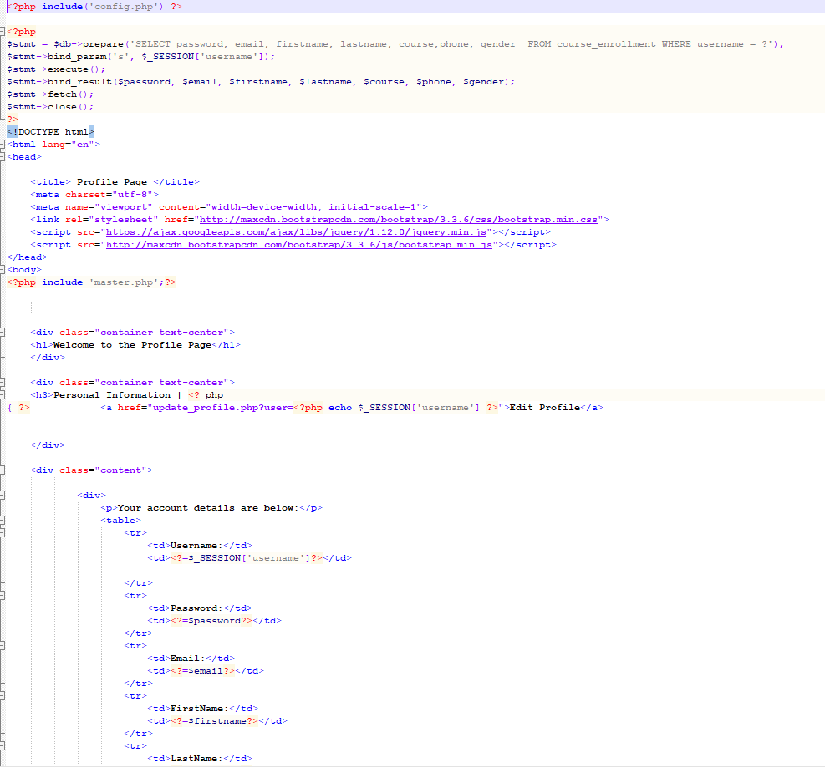
Profile page code
The first line of code in my profile is the “include” statement because I want to include the information that’s in my config code, which is all the connection information to my database. The bind_parm statement binds all the information that is stored in my database and outputs it into my profile page. The rest of the information in my code are fields so that the student can view their information.

Slide 17
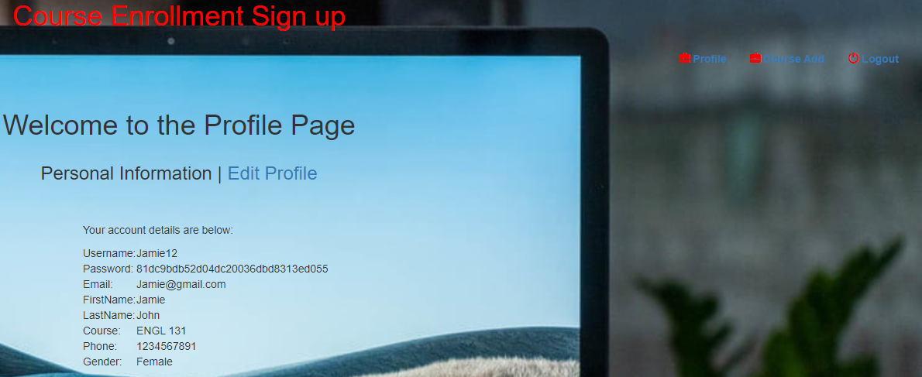
Logout function
The logout function simply log you out and directs you to the index page. The screenshot to the right shows you the student that’s logged in. In the upper right-hand corner is the logout button. Once clicked, you are directed to the index page. Also I have a screenshot of the code used to create the logout function.

Slide 18
References
Kuchta, J., & Padhiyar, P. (2018). Extracting Concepts from the Software Requirements Specification Using Natural Language Processing. 2018 11th International Conference on Human System Interaction (HSI). doi: 10.1109/hsi.2018.8431221
https://icdn3.digitaltrends.com/image/digitaltrends/microsoftsurfacelaptop3- 8-1200x630-c-ar1.91.jpg

